Slide 1
Managing and Monitoring
Windows 7 Performance
Lesson 8

Slide 2
Objectives
Configure Windows Updates with Windows Update Client and WSUS
Monitor Windows Performance using Event Viewer, Performance Information and Tools, Performance Monitor, and Reliability Monitor
Manage Windows Performance using Task Manager, Resource Monitor, Process Explorer, and System Configuration
Notes:
Outline the material you are going to cover in this lesson. Do not go into detail as each of these points will be expanded on in the lesson. You may also want to mention the Technology Skills that are being covered for the Certification exam also.

Slide 3
Updating Windows 7
Current operating systems are always a work-in-progress, constantly being updated to correct errors, enhance performance, and add features.
One of the primary tasks of a desktop technician
Should be familiar with:
  Types of update releases
  Methods for deploying updates
Notes:
Introduce Windows Updates.

Slide 4
Understanding Update Types
Hotfixes - an update consisting of one or more files designed to address a specific problem or issue with the operating system
Security updates
  a hotfix designed to address a particular vulnerability in Windows 7 security
  In addition to the software itself, security updates include a security bulletin and a Knowledge Base article that discuss the nature and severity of the problem
Notes:
Describe each update type.

Slide 5
Understanding Update Types
Cumulative updates (rollups)
  a distribution method that consolidates all of the updates for a particular operating system element or application, such as Internet Explorer or Internet Information Services
Notes:
Describe each update type.

Slide 6
Understanding Update Types
Service packs
  a cumulative set of all updates for a particular operating system version
  Unlike updates, service packs can contain new or enhanced features
Notes:
Describe each update type.

Slide 7
Update Categories
Important update
  Updates that address important issues that require immediate attention and which all users should install
Recommended updates
  Updates that address less-important issues or that apply only to certain users
Notes:
Describe the meanings of the different update categories and how you can use the categories to choose what should be updated.

Slide 8
Update Categories
Optional updates
  Updates that contain enhancements or new features that are not essential for the proper functioning of the operating system
Device drivers
  Microsoft uses Windows Update to distribute fuliy tested and digitally signed device drivers for some hardware products
Notes:
Describe the meanings of the different update categories and how you can use the categories to choose what should be updated.

Slide 9
Applying Updates
Windows Update
  For individual computers and small networks
Windows Server Update Services (WSUS)
  For medium to large networks a free product that conserves bandwidth by downloading updates from the Internet once and then providing them to Windows Update clients on the local network
Notes:
Explain the different ways companies can choose to update their Windows 7 computers. SCCM is formerly known as SMS.

Slide 10
Applying Updates
System Center Configuration Manager (SCCM)
  For large enterprise networks
  a comprehensive network management tool that administrators can use to deploy all types of software products, including operating system upgrades
Notes:
Explain the different ways companies can choose to update their Windows 7 computers. SCCM is formerly known as SMS.

Slide 11
Using the Windows Update Client
Windows Update is a pull client that periodically checks a designated server for the availability of updates

Slide 12
Three Stages of Updage Process
Detection
  At scheduled times, the Windows Update client connects to a designated server either on the Internet or the company network
  downloads the servers list of available updates and compares the list with the computer current configuration
  The client then flags all of the updates that have not yet been installed on the system for download

Slide 13
Three Stages of Updage Process
Download
  After determining which updates it needs, the client initiates a download using the Background Intelligent Transfer Service (BITS).
  using only the network's idle bandwidth

Slide 14
Three Stages of Updage Process
Install
  By default, the Windows Update client immediately installs updated after downloading them
  The Windows Update client can also be configured to allow the user to manually install the updates.

Slide 15
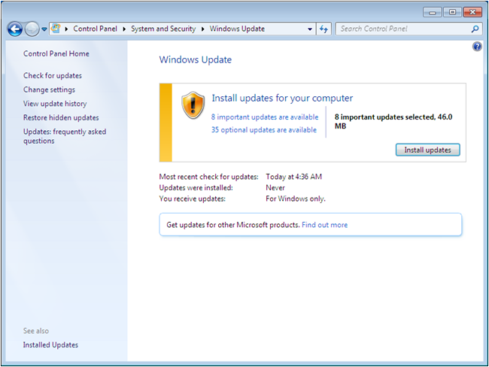
Using the Windows Update Client
Notes:
Explain the stages of Windows Update: Detection, Download and Installation.

Slide 16
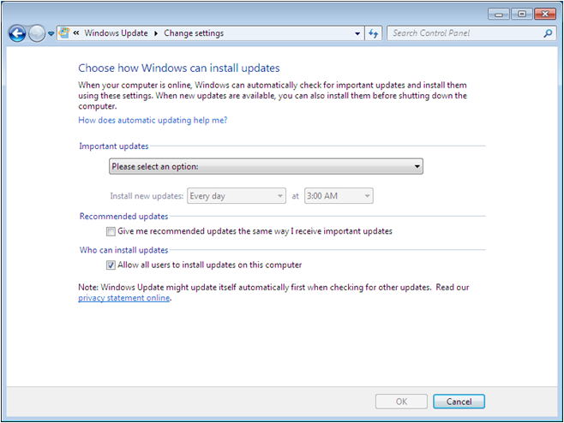
Configuring the Windows Update Client
Notes:
Discuss how Windows Update can be configured to work without user interaction by configuring it using the screen above. Discuss the Important Updates options as described on the next screen.

Slide 17
Important Updates Options
Install updates automatically (recommended)
Download updates but let me choose whether to install them
Check for updates but let me choose whether to download and install them
Never check for updates (not recommended)

Slide 18
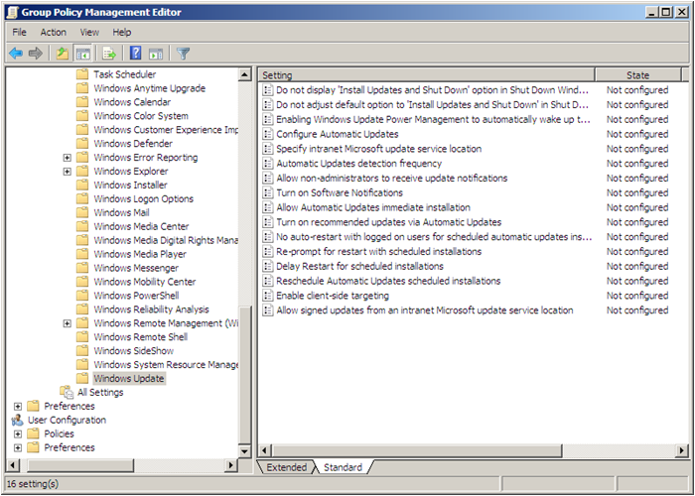
Configuring Windows Update
Using Group Policy
Notes:
In addition to the control panel interface, it is possible to configure the Windows Update client using Group Policy settings. You can use local Group Policy settings to configure the client, but system administrators more commonly distribute the settings using Active Directory Domain Services (AD DS).
Discuss some of the settings.

Slide 19
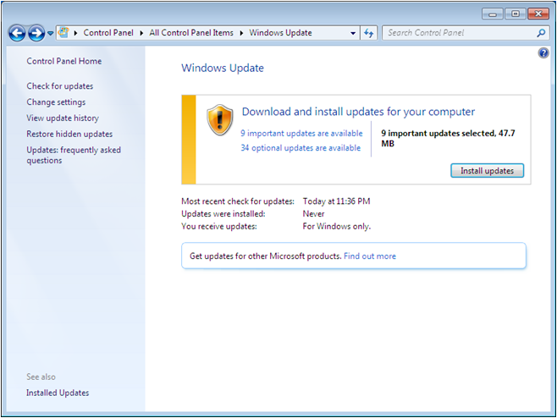
Triggering an Update
Notes:
Explain how you can trigger an update manually using the Check for Updates option on the Task List. Discuss the other options on the Task List.

Slide 20
Using Windows Server Update Services
Downloads updates from the Microsoft Update Web site
Stores them for administrator evaluation
Administrators select the updates to deploy
Computers on the network download updates from WSUS server using a reconfigured Windows Update Client
Notes:
Describe the disadvantages of having each workstation download their own updates from Microsoft Updates and introduce WSUS as the solution.

Slide 21
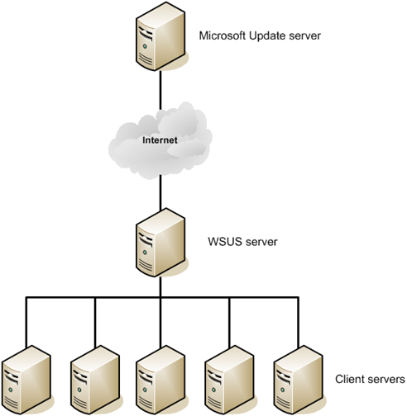
Understanding WSUS Architecture
Notes:
Use this basic architecture diagram to describe how WSUS works. Refer to other Architecture diagrams in the textbook to talk about other configurations for larger networks.

Slide 22
Deploying WSUS
Must be installed on Windows Server 2008 R2
WSUS software is a free download from Microsoft
Web-based product, therefore the Web Server (IIS) role must be added to the server
Requires a database – Windows Internal Database, or SQL Server for larger networks
Notes:
Discuss the requirements to install WSUS onto a Server. Explain how WSUS management consists of synchronization and approval of updates. WSUS is configured to regularly synchronize with either Microsoft Update or another WSUS server. The console can be used to approve updates for deployment to the client computers. Usually updates are approved after they have been tested.

Slide 23
Configuring WSUS Clients
Cannot be done in Windows Update program
Configured through Group Policy
Notes:
Describe the process of configuring clients to obtain updates from the WSUS server instead of Microsoft Update web server.

Slide 24
Monitoring Performance
For a computer to perform well, all of its components must be efficient.
Bottlenecks can effect the performance of a computer.
  Hardware bottlenecks
  Software incompatibilities
  Resource depletion
Notes:
Introduce the concept of Performance Monitoring and why we do it. Introduce the tools being discussed.

Slide 25
Using Event Viewer
Primary function is to record information about system activities as they occur and package that information into individual units, called events.
Event Viewer is the tool you use to view these events.
Events are stored in log files:
  System Log, Security Log, and Application Log
  Setup Log and Forwarded Events
Notes:
Introduce the Event Viewer Snap In and the 3 main logs that are used to store Event information.

Slide 26
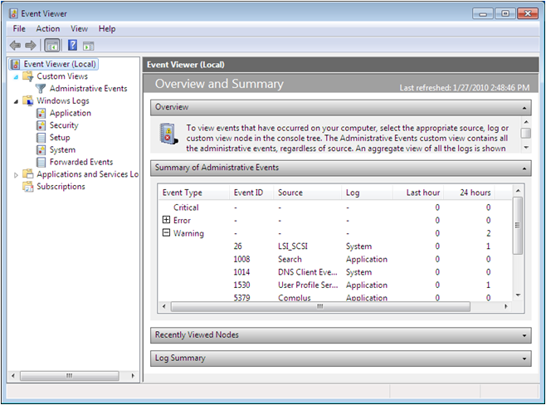
Using the Overview and Summary Display
Notes:
Describe what you see in the Summary of Administrative Events and explain that you can expand on any event type. Point out the different Windows Logs.

Slide 27
Types of Logs
Application
  Contains information about specific programs running on the computer, as determined by the application developer
Setup
  Contains information about the operating system installation and setup history

Slide 28
Types of Logs
Security
  information about security-related events, such as failed logons, attempts to access protected resources, and success or failure of audited events
  Events recorded in this log are determined by audit policies, which you can enable using either local computer policies or Group Policy

Slide 29
Types of Logs
System
  Contains information about events generated by the operating system, such as services and device drivers
  example, a failure of a service to start or a driver to load during system startup is recorded in the System log
Forwarded Events
  Contains events received from other computers on the network via subscriptions.

Slide 30
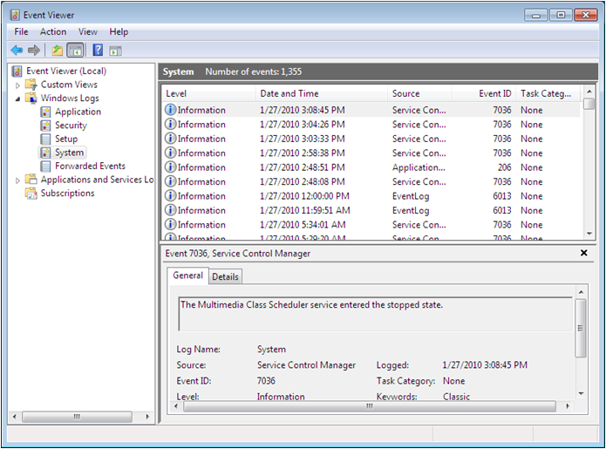
Viewing Windows Logs
Notes:
Explain that the System Log is the primary operational log. Describe the 4 different event types that can be seen in a log file: Information, Error, Warning and Critical.

Slide 31
Types of Events
Information
  An event that describes a change in the state of a component or process as part of a normal operation
Error
  An event that warns of a problem that is not likely to affect the performance of the component or process where the problem occurred, but that could affect the performance of other components or processes on the system

Slide 32
Types of Events
Warning
  An event that warns of a service degradation or an occurrence that can potentially cause a service degradation in the near future, unless you take steps to prevent it
Critical
  An event that warns that an incident resulting in a catastrophic loss of functionaliry or data in a component or process has occurred

Slide 33
Performance Information and Tools
Rates computer’s components and assigns a base score reflecting the score of the lowest rated component on your system – The bottleneck.
Hardware upgrades improve performance.
Conserve system resources to enhance performance – Tips for improving your computer’s performance link.
Notes:
See notes for next slide and use this text and the next slide to explain the concepts.

Slide 34
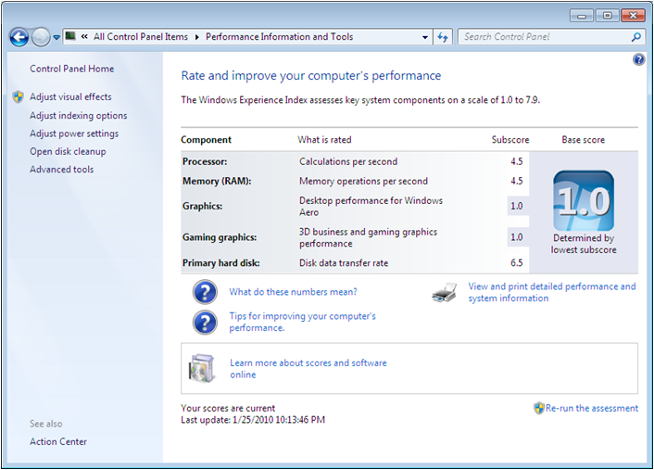
Performance Information and Tools
Notes:
Explain the Windows Experience Index. Explain how the tool breaks the computer down into 5 components, each of which is given a numerical score to gauge its performance. The base score will be the lowest scored component. To increase computer performance, you should try to raise the system’s base score. Discuss ways of increasing the base score. Discuss using the Tips for improving your computer’s performance to enhance the computer’s performance without upgrades.

Slide 35
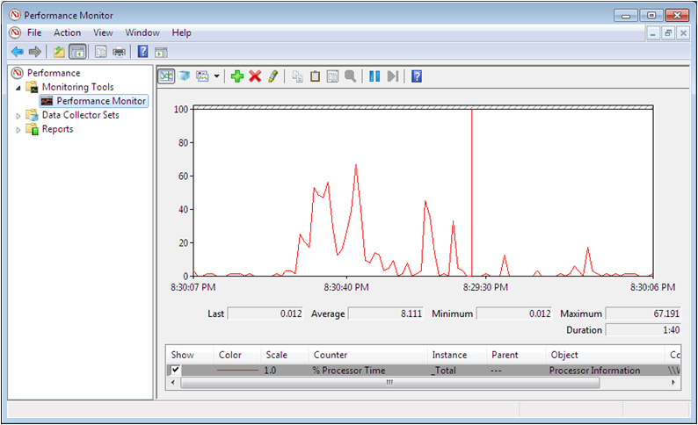
Using the Performance Monitor Console
Notes:
Performance Monitor console enables you to view similar information to the Performance Information and Tools information, but on a continuous, real-time basis. Performance Monitor is a tool that can display information for hundreds of different statistics (called performance counters) in a variety of ways. You can use Performance Monitor to create a customized graph or report containing any statistics you choose.

Slide 36
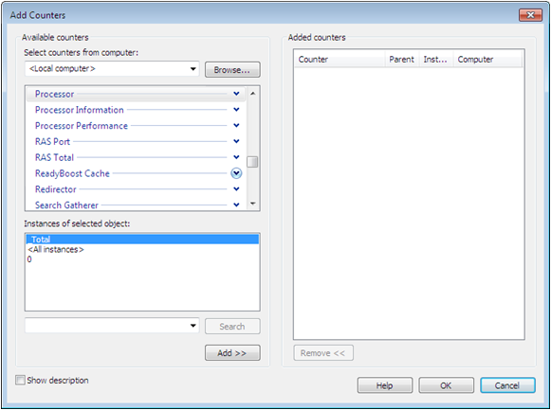
Adding Counters
Notes:
Explain the concept of adding Counters to the Performance Monitor and describe the 4 pieces of information you see on the screen: computer, Performance object, Performance Counter, Instance

Slide 37
Adding Counters
four pieces of information needed to add a counter to the display
Computer
  The name of the computer you want to monitor with the selected counter
  you specify, a computer name for each counter you add to the display
  This allows you to a display showing counters for various computers on a network.

Slide 38
Adding Counters
Performance object
  A category representing a specific hardware or software component in the computer
  the down arrow on performance object displays a selection of performance counters related to the category
Performance counter:
  A statistic representing a specific aspect of the selected performance object's activities

Slide 39
Adding Counters
Instance:
  An element representing a specific occurrence of the selected performance counter
  on a computer with two network interface adapters, each counter in the Network Interface performance object would have two instances, one for each adapter

Slide 40
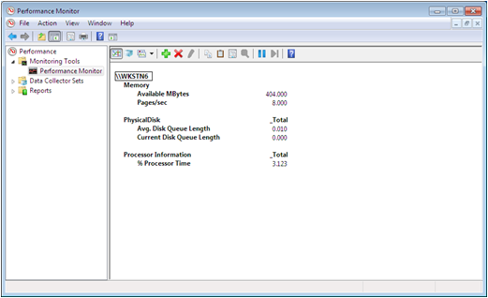
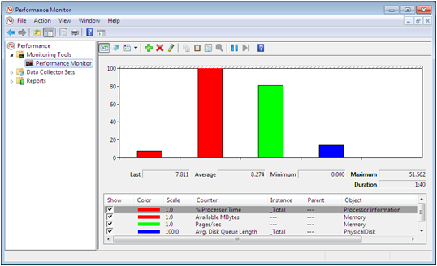
Using Other Views
Notes:
Describe the Histogram and Report views.

Slide 41
Creating an Effective Display
Limit the number of counters
  Too many counters make the graph difficult to understand
  display multiple windows in the console and select different counters in each window
Modify the counter display properties
Choose counters with comparable values
Notes:
Explain how to create an effective display and why it is important.

Slide 42
Creating an Effective Display
Choose counters with comparable values
  Choose counters with values that are reasonably comparable so that you can display them legibly
  -When a graph contains a counter with a typical value that is under twenty and another counter with a value in the hundreds, it is difficult to arrange the display so that both counters are read
Notes:
Explain how to create an effective display and why it is important.

Slide 43
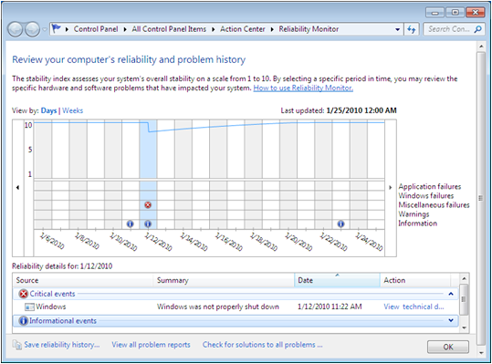
Using Reliability Monitor
Collects and tracks information about system stability to calculate a stability index
Notes:
Explain how the stability index is a number from 0-10 calculated by the events: software (un)installs, Application Failures, Hardware Failures, Windows Failures, Misc Failures, System Clock Changes.

Slide 44
Managing Performance
Windows 7 includes a variety of controls and technologies that enable technical specialists to enhance and fine-tune the performance of their workstation:
  Task Manager
  Resource Monitor
  Process Manager
  System Configuration tool
Notes:
Introduce the concept of managing performance and briefly introduce the tools.

Slide 45
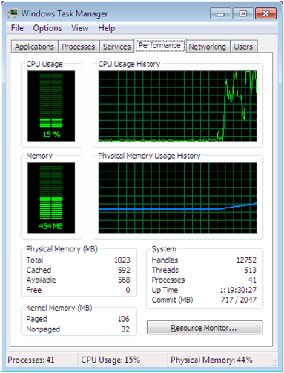
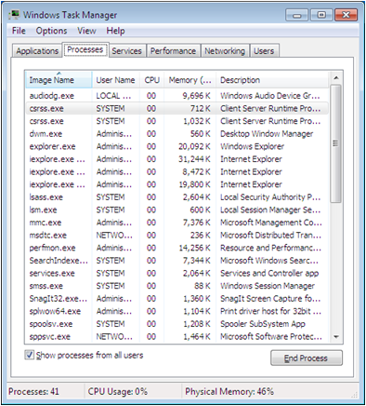
Task Manager
Notes:
Use the screen shots on the slide to describe the ways the Task Manager can help you to manage performance and processes on your computer.

Slide 46
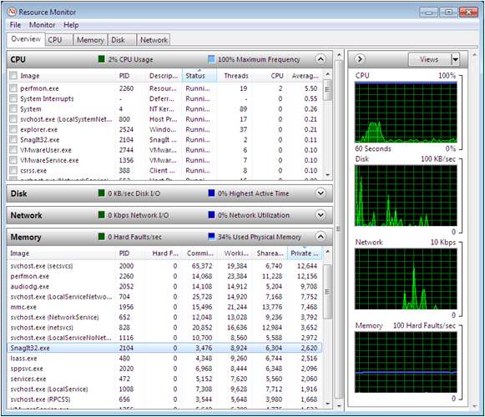
Resource Monitor
Notes:
The Resource Monitor window displays a more comprehensive breakdown of process and performance statistics. Discuss the statistics shown on the screen.

Slide 47
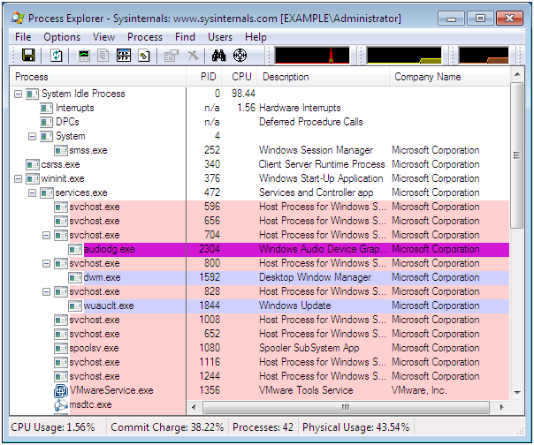
Using Process Explorer
Notes:
For even greater statistical detail, you can download the Process Explorer application from Microsoft’s web site

Slide 48
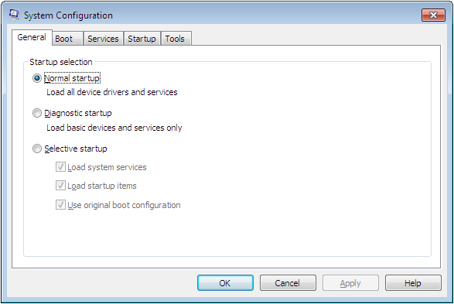
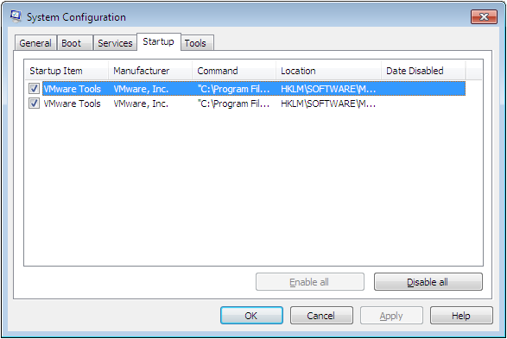
Using the System Configuration Tool
Notes:
The System Configuration tool (Msconfig.exe) is designed primarily to configure and troubleshoot the Windows 7 startup process. Discuss the contents of the screens shown.

Slide 49
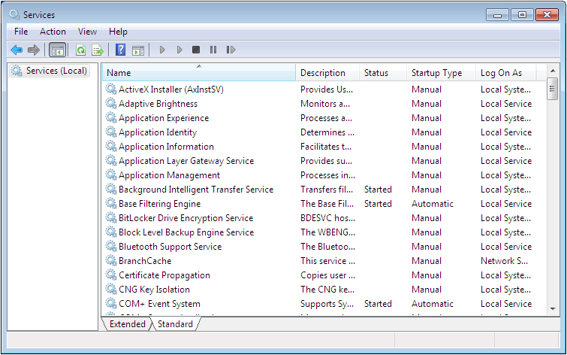
Managing Services
Notes:
Windows 7 loads a large number of services automatically when the computer starts. Disabling the services he workstation does not need can free up resources and improve the computer’s performance.

Slide 50
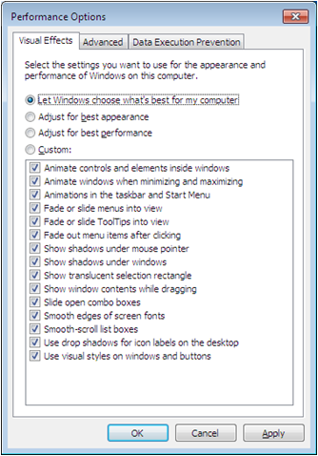
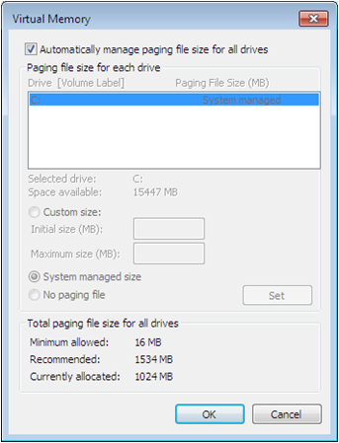
Configuring Performance Option Settings
Notes:
The Performance Information and Tools control panel, in addition to the monitoring capabilities discussed earlier, also has links to a number of performance tuning tools.
Discuss the contents of the screens above.

Slide 51
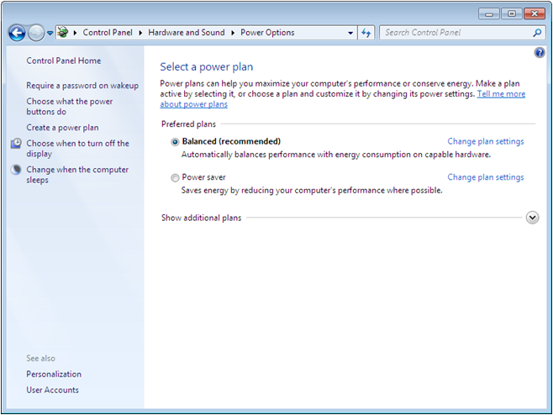
Configuring Power Settings
Notes:
The power configuration settings in Windows 7 enable you to throttle various system components to optimize their power utilization, which can also have an effect on system performance.
Discuss the different power settings.

Slide 52
Configuring Hard Disk Caching
Trade off between safety and performance
Write caching is when the device stores data in temporary memory until the slower devices can catch up – Disk writing can happen in the background while a user continues to work
Clearing the Enable write caching on the device increases safety but reduces disk performance

Slide 53
Using ReadyBoost
Enables you to use the storage space on a USB flash drive to free up system memory for other uses
Notes:
Explain the enhancements of ReadyBoost over Vista. Explain how it uses the non-volatile memory cache for SuperFetch information. Explain SuperFetch

Slide 54
Skills Summary
Keeping Windows 7 systems updated is one of the primary tasks of the technical specialist, who should be familiar with the types of update releases and the methods for deploying updates.
Event Viewer is used to display log information gathered by the operating system.
Performance Information and Tools page provides a snapshot of your computer’s performance.
Performance Monitor console enables you to view much of the same information, but on a continuous, real-time basis.
Notes:
Review the Skill Summary to wrap up your lesson.

Slide 55
Skills Summary (cont.)
The Resource Monitor program contains four real-time line graphs that display information about four of the main system hardware components.
Reliability Monitor calculates a stability index.
Windows 7 provides a variety of tools for monitoring and managing processes.
ReadyBoost enables Windows 7 to use the storage space on USB devices to free up system memory.

